Slide 1
Watson Use Cases
Joe Kozhaya
IBM Watson Solution Architect
kozhaya@us.ibm.com
@joe4k

Slide 2
Powered-by-Watson Solutions
Marketing Campaign Analytics Solutions
Sentiment Analysis, Visual Recognition
Expert Advisor solutions
Question/Answer use cases leveraging Retrieve&Rank, Natural Language Classifier
Consumer Advisor solutions
Question/Answer use cases leveraging R&R, NLC, and Dialog (Conversation)
Targeted Marketing, Customer Acquisition, Personal Connections
Personality Insights, Tone Analyzer
Text/Image Analytics
Alchemy Language, Concept Insights, Visual Recognition
Robotics
Speech-to-Text, Text-to-Speech, Language Translation
Discovery
AlchemyAPI Data, WKS/AlchemyLanguage (custom models)

Slide 3
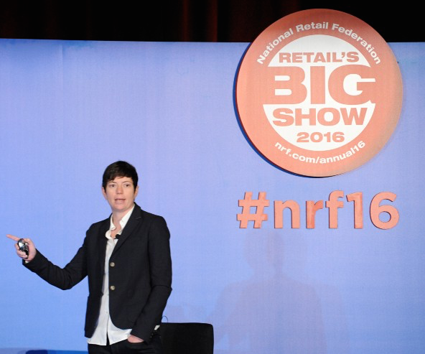
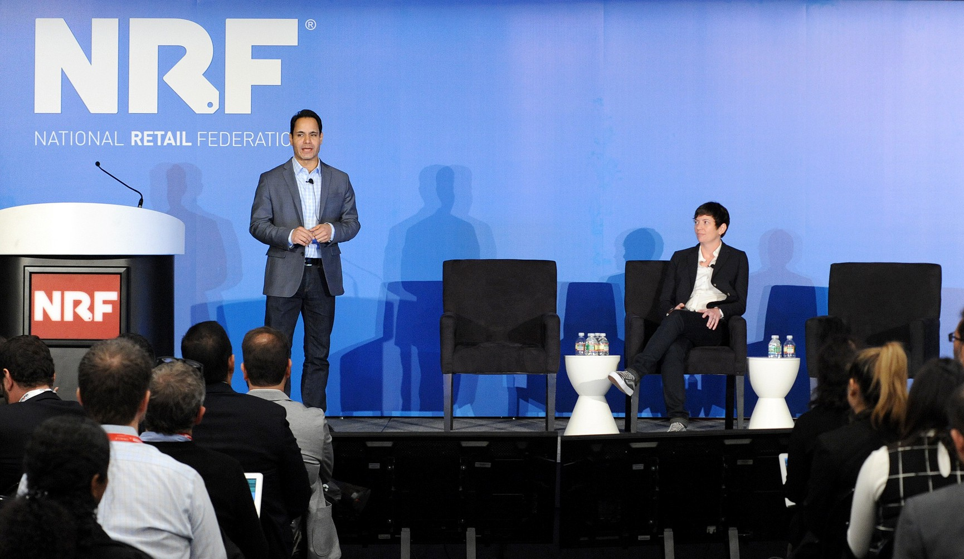

Creates e-commerce experiences and software that transform how people shop by personalizing the process.
The Challenge
Online and mobile shoppers need to have the same personalized shopping experience that they would in a store
The Solution
Fluid’s Expert Personal Shopper replicates the personalized experience of talking with an expert to provide quick, accurate and personalized outwear recommendations that are tailored to their needs.
The APIs
Watson QA
Moving towards using Watson Knowledge Studio/Alchemy Language
https://www.youtube.com/watch?v=x6p05Oc6Ih0
http://bit.ly/1nQbo29

Slide 4

The Challenge
How can you find the right wine for you, that pairs well with your meal?
The Solution
Wine4.Me creates a personalized shopping experience that significantly increases the probability that consumers will purchase more wines they like.
The APIs
Natural Language Classifier
http://wine4.me/
https://www.youtube.com/watch?v=OWUwviuTtMM

Slide 5

A software solution that enables clients to gain a richer understanding of global science and technology resources. Clients can search thousands of networks for results, and visualize this data to create insights.
The Challenge
It is challenging to visualize the results of thousands of global scientific data sources.
The Solution
Inno360 spans a number of key workflows and tasks to help find, engage and collaborate with both external innovators and colleagues.
The APIs
Sentiment Analysis
AlchemyLanguage Keywords/Entities/Concepts/Taxonomy
https://vimeo.com/143275739 pw: watson

Slide 6
next IT
Provides advanced conversational capabilities for enterprise customers and is currently deploying Intelligent Virtual Assistant solutions in the enterprise space on various channels
The Challenge
It is challenging to create a 1:1 repeatable digital experience.
The Solution
Creating industry-leading intelligent virtual assistants (IVAs)
Providing personalized service on the customer’s terms anytime, anywhere, through conversation
Interacting with customers the way they want—talk, tap, type
Delivering solutions that revolutionize how technology interacts with people
Capturing valuable customer insights
The APIs
Text to Speech
Language Identification
http://www.nextit.com/

Slide 7
Resolver
Resolver assists businesses to effectively resolve customer issues by helping businesses to effectively understood the consumers issues and to auto predict the best personalized resolution for that consumer.
The Challenge
Consumers remain loyal as their issues were simply resolved
The Solution
Personalized resolution uses Watson AI to auto predict the best resolution based on profile insights, emotion and previous issues resolution.
The APIs
Natural Language Classifier
Entity Extraction
Keyword Extraction
https://vimeo.com/72630634

Slide 8

An intelligent personal guide to health optimization that drives engagement through a dynamic and informed health dialogue.
Knows Your Consumer
Dialogue is based not only on demographics and health status, but also on benefits, interests and behavioral characteristics.
Learns Your Resources
Knows the consumers’ available resources and incorporates them into meaningful conversations with the user.
Discovers and Refines Over Time
Ongoing, interactive engagement provides dynamic insight that refines user recommendations over time.
The APIs
Natural Language Classifier/Dialog(Conversation)
https://www.youtube.com/watch?v=XqHn1AS9Jp0

Slide 9
CaféWell Concierge - Value Proposition
An intelligent personal guide to health optimization that drives engagement through a dynamic and informed health dialogue.
Knows Your Consumer
Dialogue is based not only on demographics and health status, but also on benefits, interests and behavioral characteristics.
Learns Your Resources
Knows the consumers’ available resources and incorporates them into meaningful conversations with the user.
Discovers and Refines Over Time
Ongoing, interactive engagement provides dynamic insight that refines user recommendations over time.
The APIs
Natural Language Classifier/Dialog(Conversation)
https://www.youtube.com/watch?v=XqHn1AS9Jp0

Slide 10





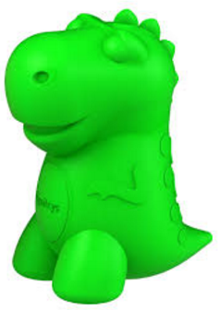

Partner Demos and Applications
Leverage Retrieve&Rank and NLC to enable clinicians to access curated, evidence-based, peer-reviewed disease-specific content on a mobile platform where they needed most (@ point of care).
https://www.youtube.com/watch?v=B72EQtnxJ2k
Leverage Watson QA in their CafeWell Concierge app to enable health plans and managers to optimize their clients’ health by providing personalized wellness coaching and guidance.
https://www.youtube.com/watch?v=XqHn1AS9Jp0
Leverage Watson QA in their Patient-centered Care Coordination Platform to deliver personalized health suggestions.
https://www.youtube.com/watch?v=ktphsGjL8xE
Leverage NLC to enable Ivy to offer outstanding customer service by understanding guests intent and provide immediate answers to maximize guest satisfaction.
https://www.youtube.com/watch? v=ZV19ROgRXNI
Leverage PI and TA to find best matching schools for students based on their personality profiles
https://www.youtube.com/watch?v=kq_jUJie1YE
Leverage Dialog to build an intriguing game chat thriller
CogniToys leverage Watson QA to build a teaching game for kids.
https://www.youtube.com/watch?v=MQBs9RVAkcg
https://vimeo.com/120550878

Slide 11
Thank You

